Slide 1
Educational Spending and Test Scores
A look into state per student spending and college entrance exam outcomes

Slide 2
Problem Statement
My project is going to analyze the impact of educational spending on college entrance exam testing outcomes on a per state basis.
This aims to help educators, lobbyists, and state budget planners make more informed decisions when asking whether increased state investment is helpful or necessary.

Slide 3
Data Selection
I chose to examine 2018 and 2019 act and sat scores by state. I believed since these were more recent, the data might make for more interesting analysis, as test scores tend to rise year over year.
To compare to expenditure, I had to craft my own dataset, using information found on https://www.governing.com/finance/Education-Spending-Per-Student-By-State.html
Unfortunately, I was confined to using 2018 data, because 2019 was not available yet.

Slide 4
Exploratory Data Analysis
Early analysis displayed a significant difference in testing participation between states, with an inverse relationship between SAT and ACT. States that had high participation in one, tended to have lower participation in the other.
Many states had nearly 100% participation rates which was surprising, but might help explain some of our findings.

Slide 5
Data Cleaning
There needed to be a few things worked on to get the participation strings placed into float rates.
Additionally there were a few stubborn string values that I just turned into a null and then replaced with the mean of the column.

Slide 6
Results
An initial glimpse at the relationship between SAT and per student spending was pretty surprising:
dfsat["total"].corr(dfsat["perstudentspending"])
-0.20627623374673684
While ACT and per student spending was closer to expected, albeit still lower than I would have expected:
dfact["composite"].corr(dfact['perstudentspending'])
0.42402241769437427

Slide 7
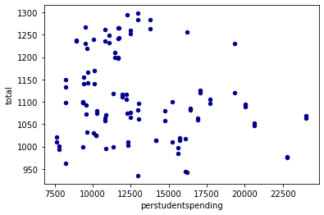
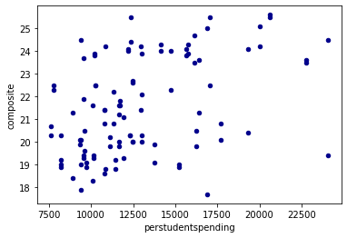
Results cont.
SAT ACT

Slide 8
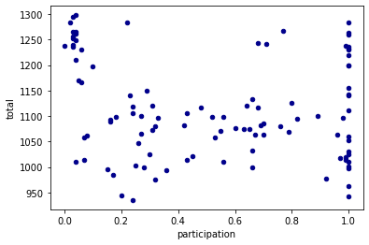
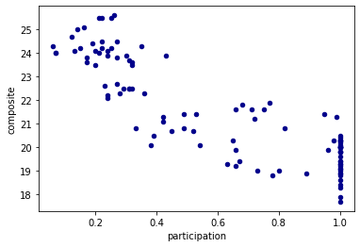
Results cont.
A bit surprised I decided to look at some other metrics
SAT ACT

Slide 9
Conclusions
Very little relationship between per student spending and participation, but even more astounding is the very clear negative relationship between participation and test outcomes.
Particularly true for the SAT, there is little incentive to increase spending beyond the national average on a per student basis, if test performance is your goal. However, there could be a myriad of other reasons per student expenditure is still important, as testing is not the only goal of education.
Overall, this data does suggest that keeping up with the national average of per student spending is a worthy goal and one that will ensure at the very least that the students are given adequate opportunities to test well, with the exception of if the state is more focused on the ACT, as there is a moderate relationship between increased spending beyond the national average and student outcomes.

